Slide 1
High-resolution imaging of skin deformation shows that afferents from human fingertips signal slip onset
Delhaye BP^{1,2}, Jarocka E³, Barrea A^{1,2}, Thonnard J-L^{1,2}, Edin BB¹, Lefèvre P^{1,2}
Elife 2021
¹Institute of Information and Communication Technologies, Electronics and Applied Mathematics, Université catholique de Louvain, Louvain-la-Neuve, Belgium
²Institute of Neuroscience, Université catholique de Louvain, Brussels, Belgium
³Department of Integrative Medical Biology, Umeå University, Umeå, Sweden
Presented by: James Goodman
Neurobiology Group Journal Club
11 May 2021

Slide 2
Why this paper for this group?
There is a general, at least passing interest in touch research
This paper studies a stimulus class often neglected, yet quite important, in touch research
The methodology is impressive and likely of general interest

Slide 3
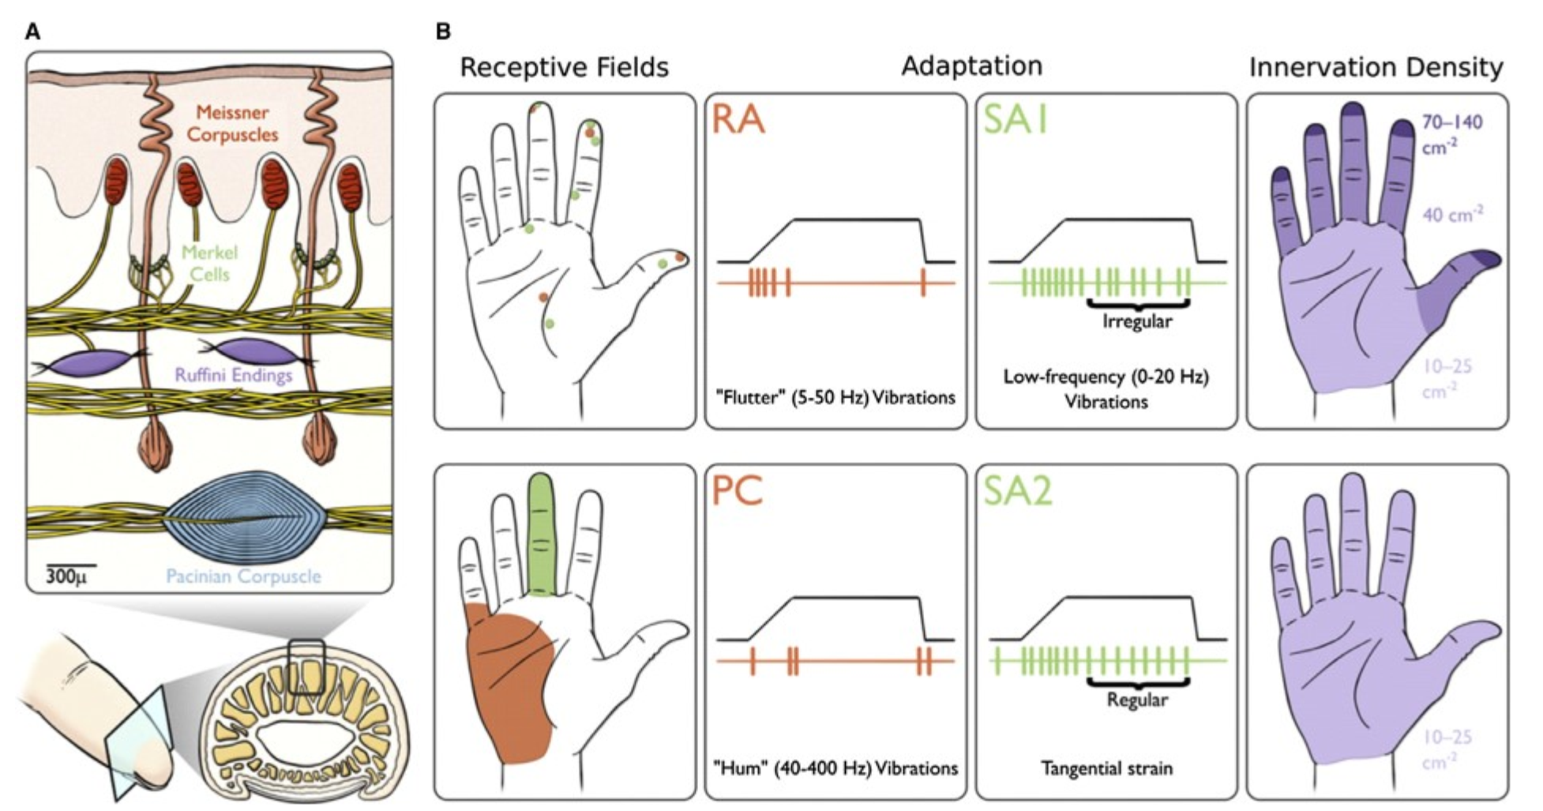
Tactile afferents: a review
Adapted from: Vallbo & Johansson 1984 Hum. Neurobiol.

Slide 4
Tactile afferents: a review
FA1
FA2
By Kenzie Green for Goodman & Bensmaia 2020 The Senses.
Adapted from: Vallbo & Johansson 1984 Hum. Neurobiol.

Slide 5
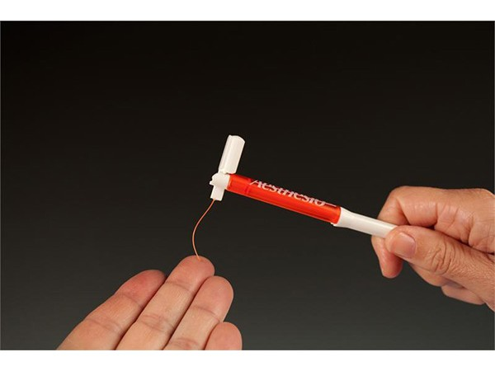
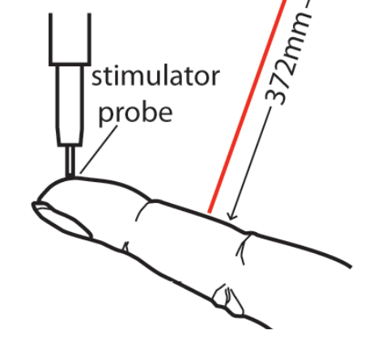
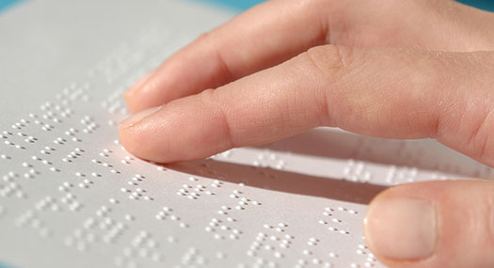
Normal perturbations are the typical context studied
Image credit:
von Frey filament merchant:
Bioseb
bioseb.com
Image credit:
Manfredi et al. 2012 PLoS One
Image credit:
American Foundation for the Blind
afb.org

Slide 6
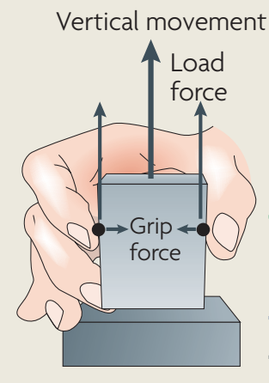
During movement, tangential perturbations are important
Johansson and Flanagan 2009 Nat Rev Neurosci

Slide 7
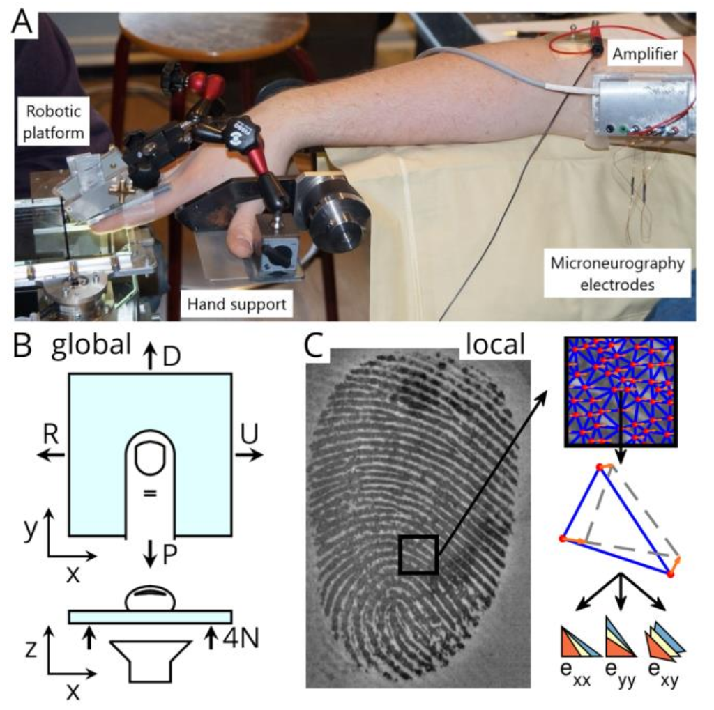
Setup at a glance

Slide 8
Stimulus: a smooth, tangentially-shifting plane with a camera imaging from underneath

Slide 9
Image processing technique to compute tangential strains and contact area

Slide 10
Image processing technique to compute tangential strains and contact area
Grid sampling of features on frame 1
Optical flow algorithm to automatically track features
Delaunay triangulation
Green-Lagrange strains of those triangles

Slide 11
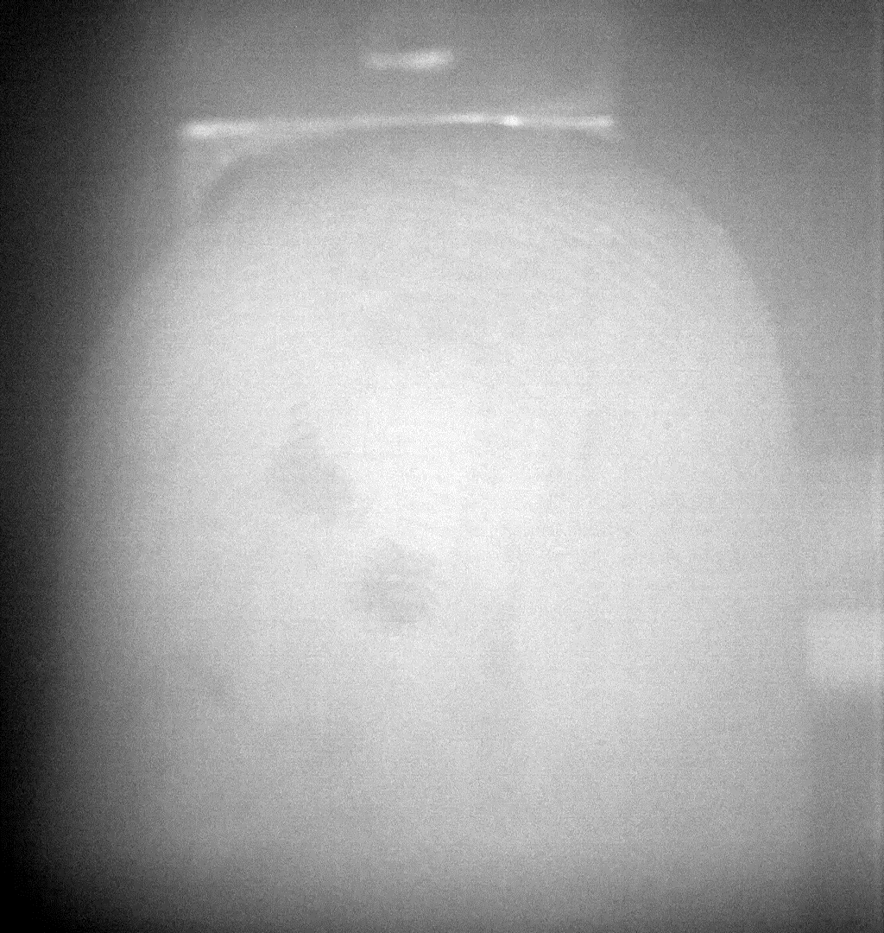
What the experiment looks like in motion: example FA-1 unit

Slide 12
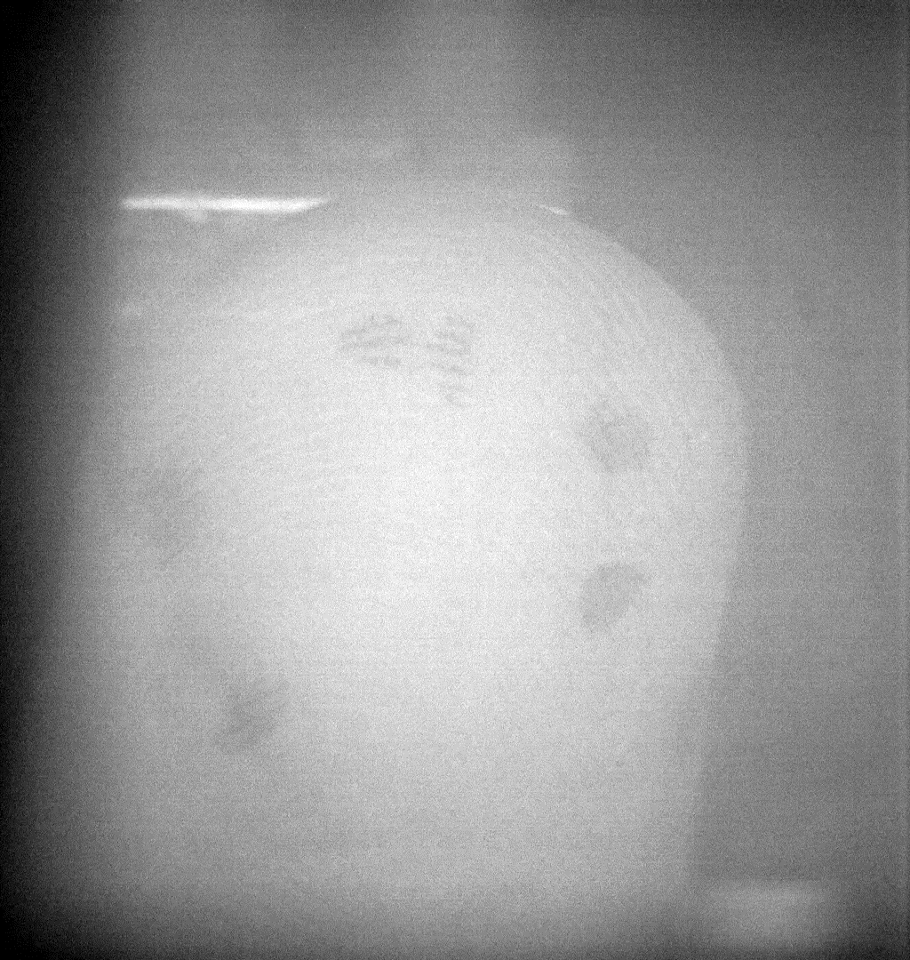
What the experiment looks like in motion: example SA-1 unit

Slide 13
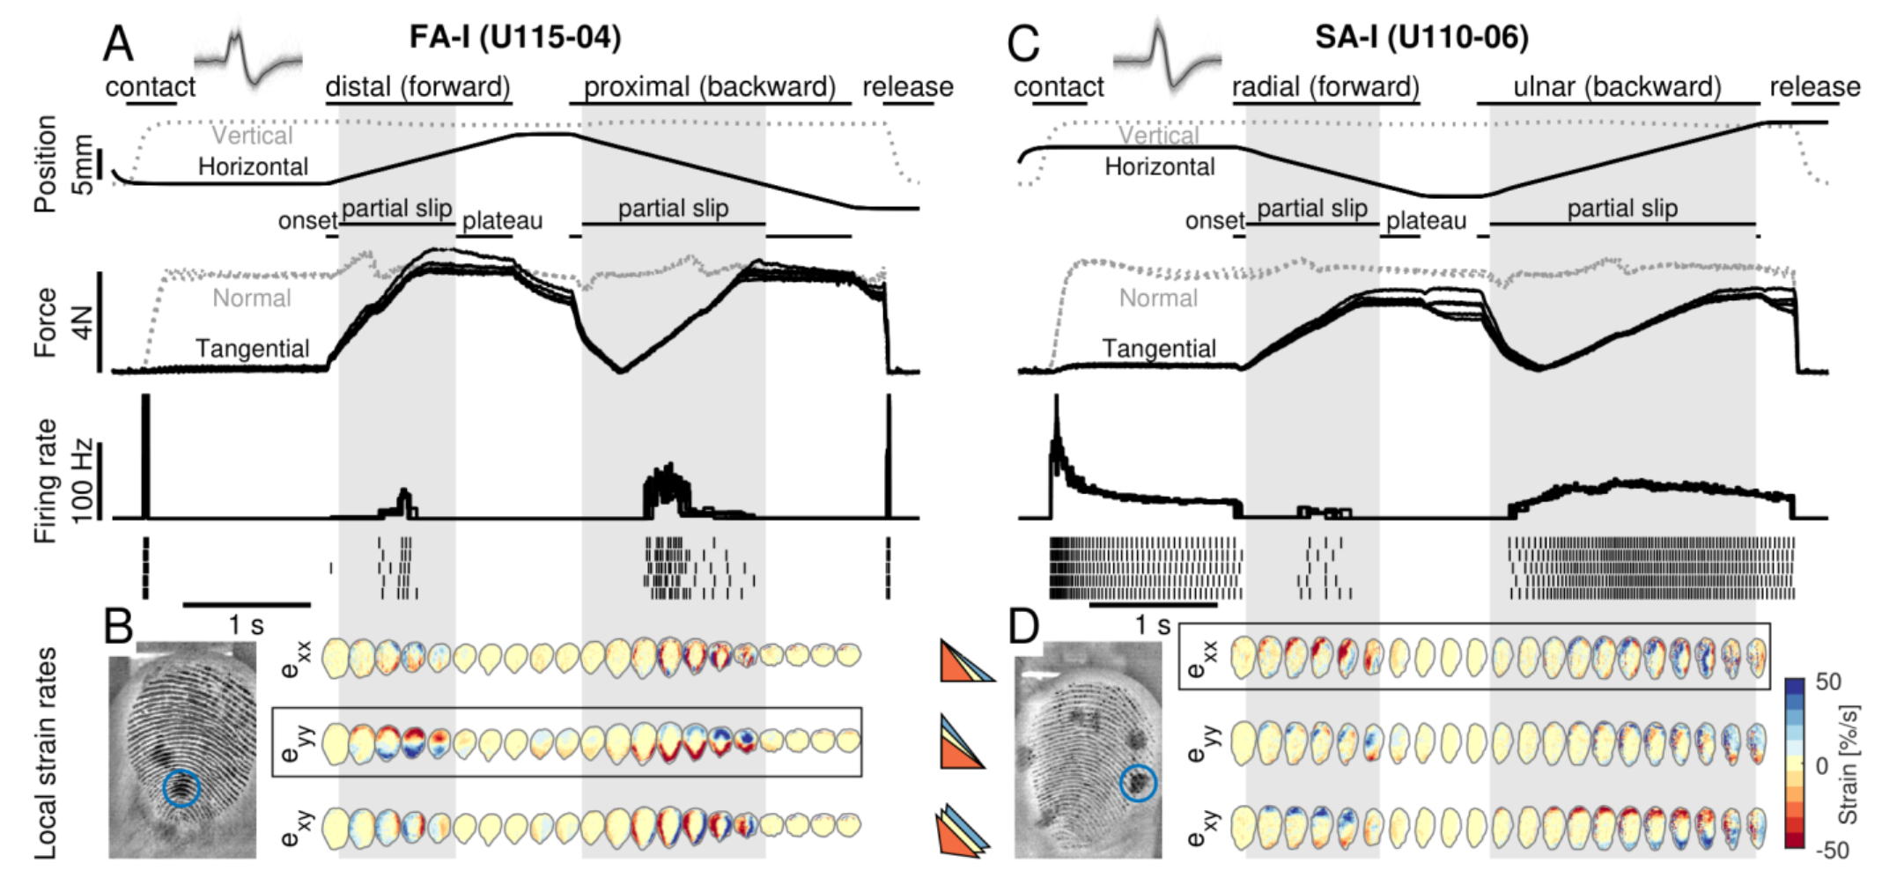
Example FA-1 and SA-1 unit data

Slide 14
Example FA-1 and SA-1 unit data
Stimulus
Kinematics

Slide 15
Example FA-1 and SA-1 unit data
Stimulus
Kinetics

Slide 16
Example FA-1 and SA-1 unit data
Afferent
Spiking

Slide 17
Example FA-1 and SA-1 unit data
Local
Strains

Slide 18
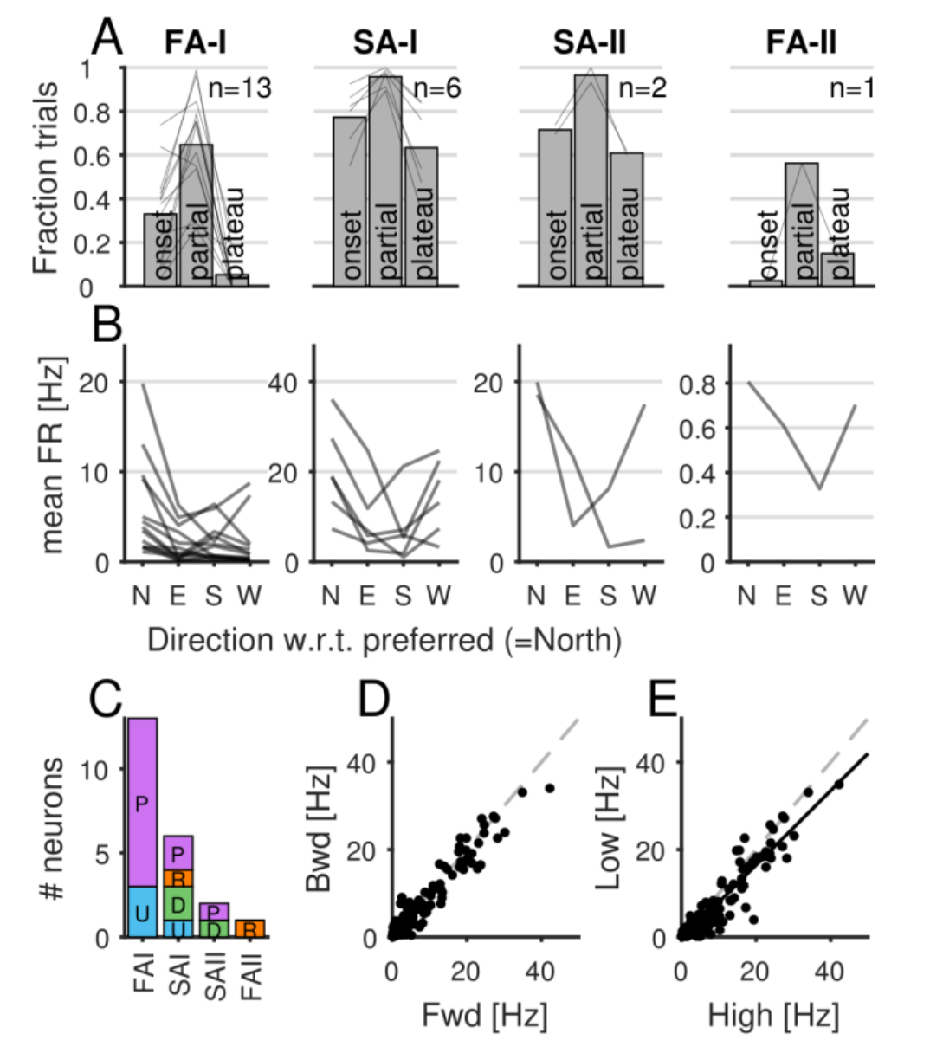
Global stimulus preferences

Slide 19
Global stimulus preferences
Fraction of trials
with significant response
(average across neurons)

Slide 20
Global stimulus preferences
Average firing rate
during “Partial slip”
w.r.t. scanning direction
(N = preferred direction)

Slide 21
Global stimulus preferences
Distribution of scanning
direction preferences

Slide 22
Global stimulus preferences
Firing rate when preferred
direction came first (Fwd)
or second (Bwd)

Slide 23
Global stimulus preferences
Firing rate when surface
was untreated (High friction)
or treated (Low friction)
Notes:
they also claim to have compared spiking to (GLOBAL) normal force fluctuations and to have found no relationship between neuronal responses & that trace

Slide 24
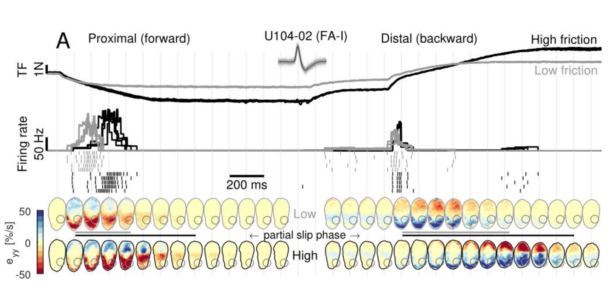
Local strains explain responses to different friction

Slide 25
Local strains explain responses to different friction

Slide 26
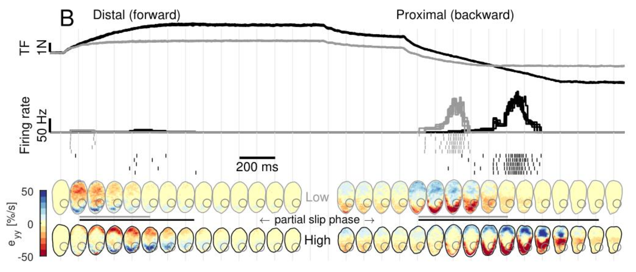
Local strains explain responses to different friction (reversed stimulus)

Slide 27
Local strains explain responses to different friction (reversed stimulus)

Slide 28
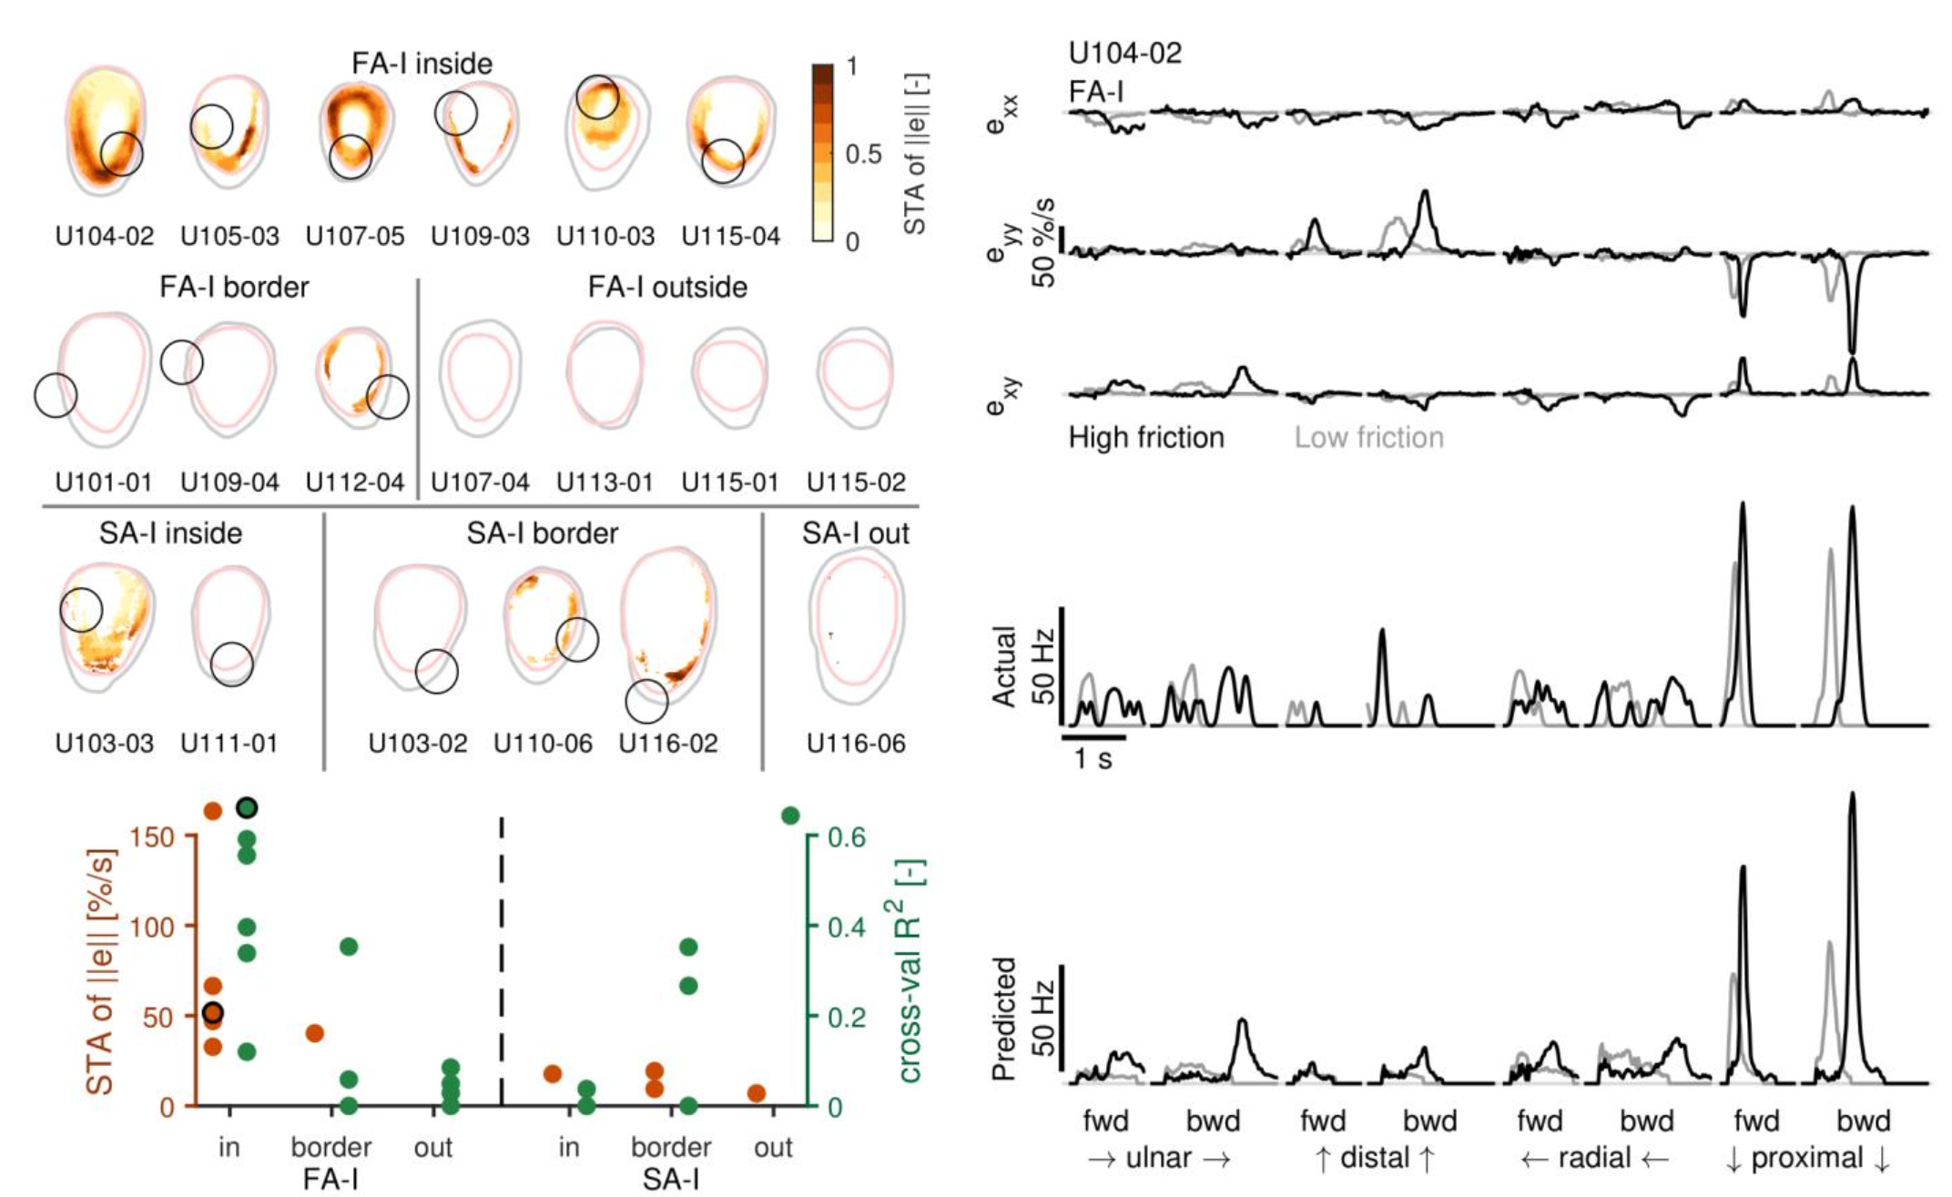
Spike-triggered averages suggest FA1 afferents are the most sensitive class

Slide 29
Spike-triggered averages suggest FA1 afferents are the most sensitive class

Slide 30
Spike-triggered averages suggest FA1 afferents are the most sensitive class
Notes:
they also fit cross-validated regression models that show similar patterns as the STAs
that’s what the green points are
We’ll get into a similar analysis soon enoug

Slide 31
Spike-triggered averages suggest FA1 afferents are the most sensitive class
local strain
components
recorded
spiking
predicted
spiking
Notes:
example unit

Slide 32
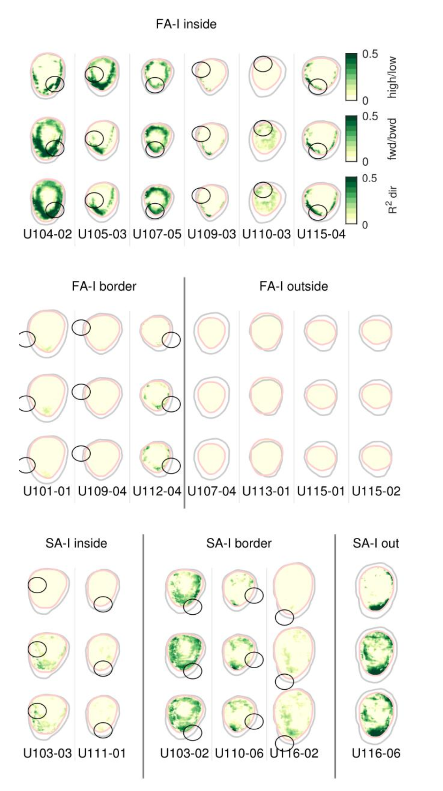
Supplement: cross-validated R² heatmaps

Slide 33
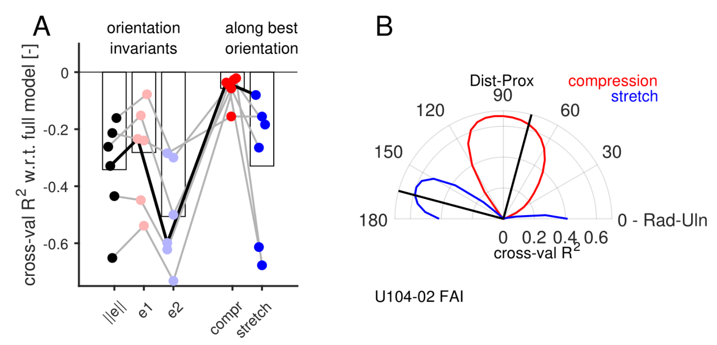
FA1 afferents specifically prefer compressive strains

Slide 34
FA1 afferents preferentially respond to oriented, compressive strains
predictor sets used in linear models

Slide 35
FA1 afferents preferentially respond to oriented, compressive strains
preferred directions of compressive
and tensile strains
Notes:
important because they make a point about incompressibility

Slide 36
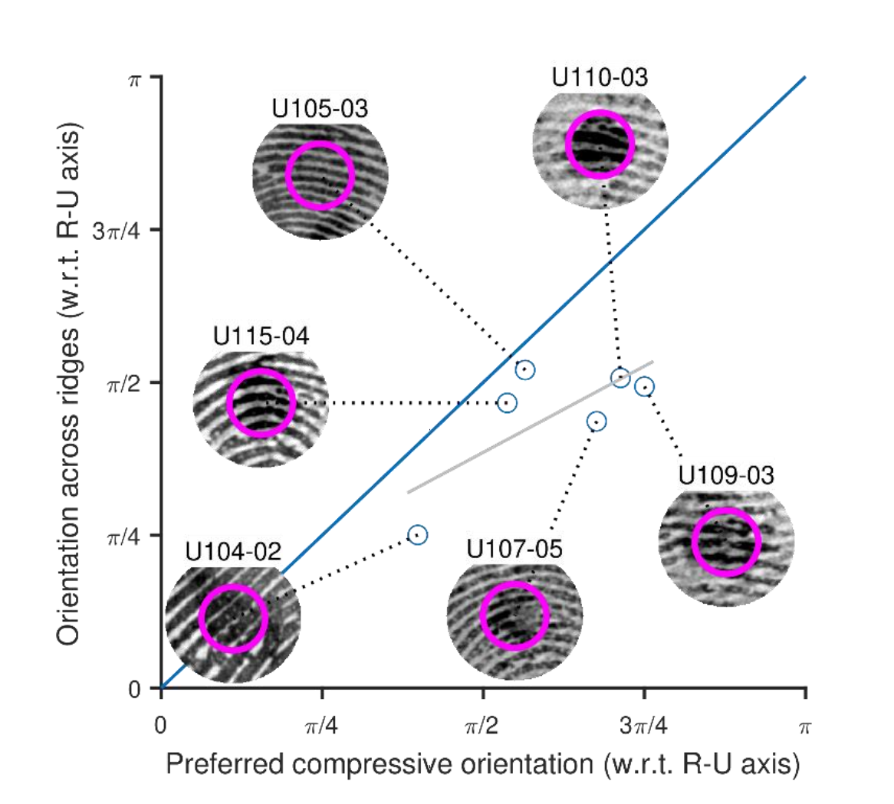
Possible (but not yet significant) relationship to fingerprint ridge orientation?
Notes:
important because they make a point about incompressibility

Slide 37
Conclusions
Tangential strains are sufficient to excite SA1 and FA1 tactile afferents
FA1 afferents seem to be most responsive to tangential strains
They respond specifically to highly localized patches of tangential strain
They tend to respond preferentially a specific orientation of compressive strain
Simple strain sensitivity is sufficient for slip sensation!
Complicated computation of surface friction or texture is not required!
Suitable for rapid grip adjustments

Slide 38
Critiques
Base result seems obvious: yes, afferents will respond to this
Sustained, global normal force seems quite high (4N, or 400g)
Pontificating about a tangential vs. normal force framework is a bit misguided
(In any case, the compressive-strain preference could be explained by sensitivity to local normal pressure)
Sustained strains could not be properly measured for SA1 afferents, so an FA1-centric interpretation seems extremely hasty (and misguided)
Notes:
point 2: the normal force applied seems quite high for this line of work. Probably in line with what you’d “naturally” use to hold an object, but scientifically, if you want to make a point about tangential forces, why only use one normal force and one that’s so damn high at that?
point 3: what’s important is strain at the receptor, not whether it’s tangential vs. normal at the surface
point 5: used dead reckoning for their (briefly) mentioned sustained strain models, but c’mon, y’all watched the same video I did.
Also, these hasty “single afferent class mediates functionally important thing” stories are VERY old-school. Functional evidence alone supports pooling across all afferent classes for all sorts of computations. You gotta point to a circuit or somehow selectively knock out/stimulate an afferent class to make a claim like this in this day and age.

Slide 39
Credit where it’s due
Impressive methodology
Detailed data
Tackle a seldom-studied, yet important tactile stimulus class

Slide 40
So... what can WE take away from this?
Exchange across fields:
6 “good” units isn’t much, but microneurography is hard
“Single afferent class supports function” is still a very popular framework – probably strange for cortical folks!
Odd discussions about which features neurons really encode are super common – reminiscent of the coordinate frame wars
Do we want to do touch?
If so, it’s hard!
Vibratory tactors on the fingertips would likely be an impoverished stimulus for grasp control
Possible cues for DLC people?
Optic flow / similar methods to increase labeling throughput?

